Slide 1
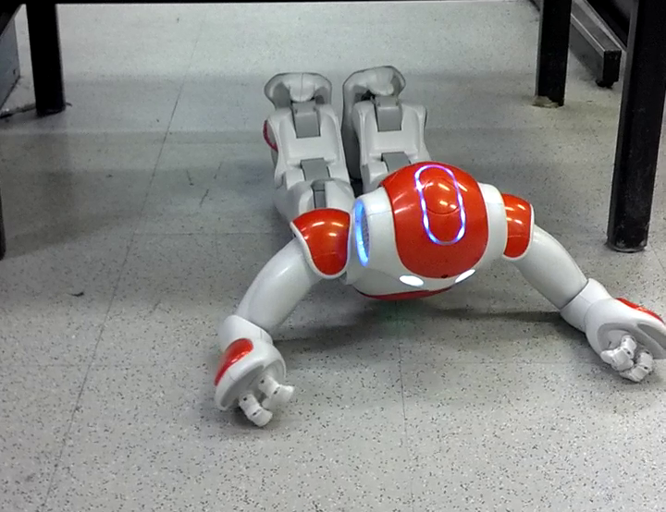

Projected Profile
Humanoid Crawl Gait
And
Lidar Based Navigation
Using GODZILA
Griswald Brooks
Advisor: Dr. Farshad Khorrami
12/22/2016

Slide 2
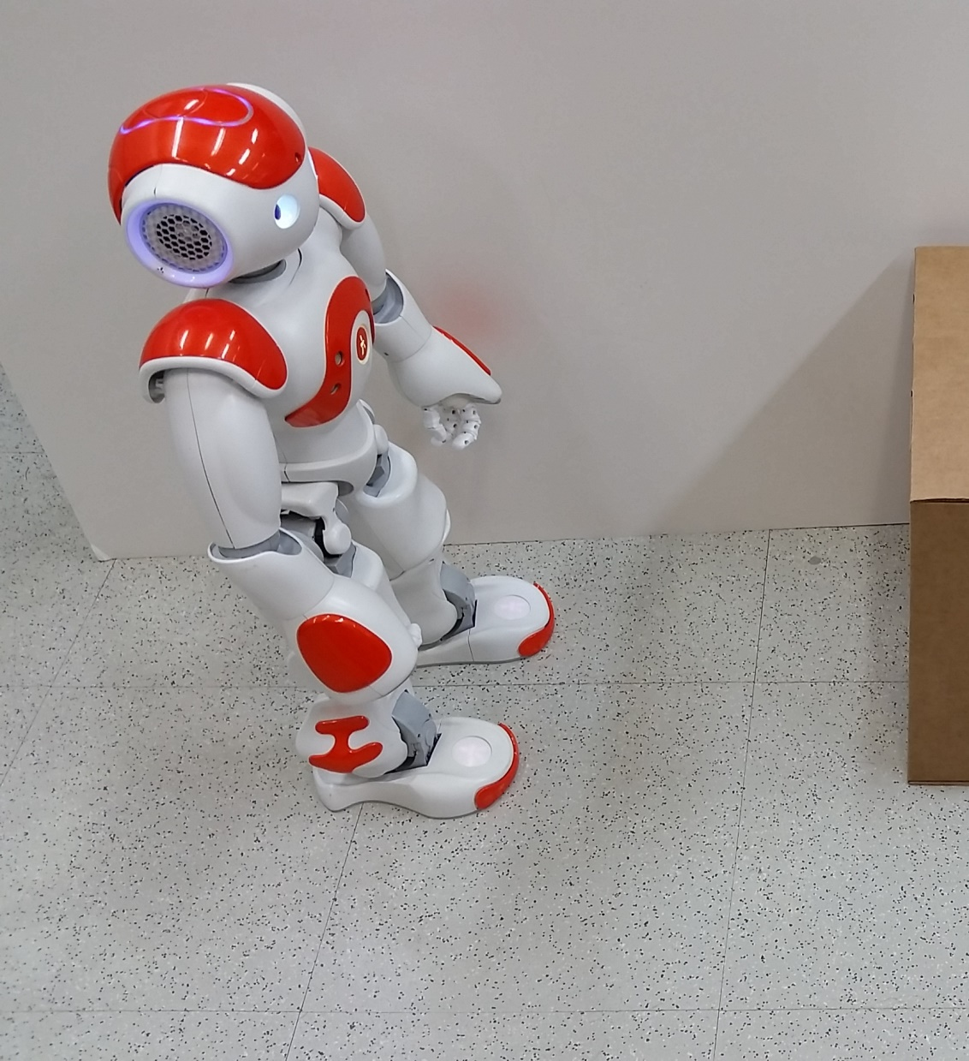
Presentation Outline

Slide 3
Presentation Outline
Introduction
Platform
GODZILA Navigation
Projected Profile Gait
Gait Optimization
Conclusion
12/22/2016
3

Slide 4
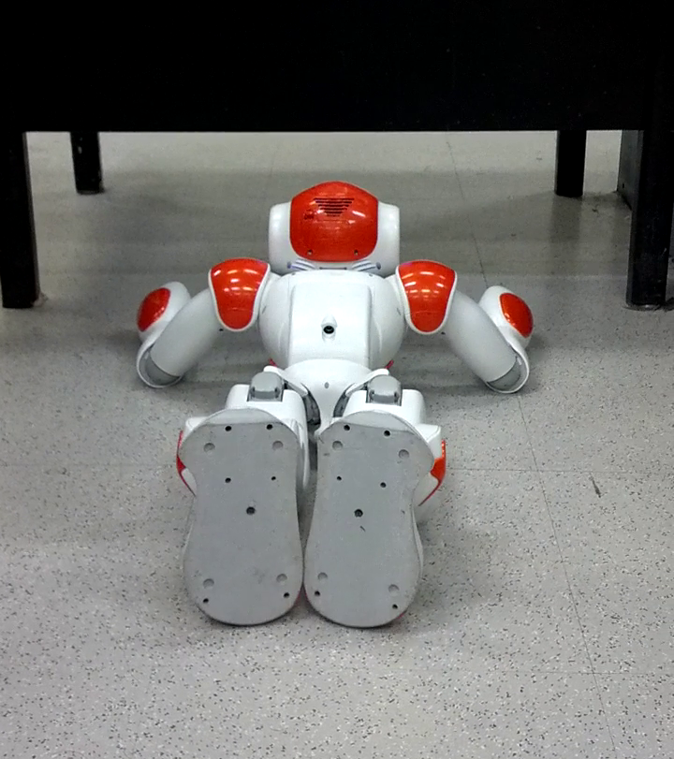
Introduction

Slide 5
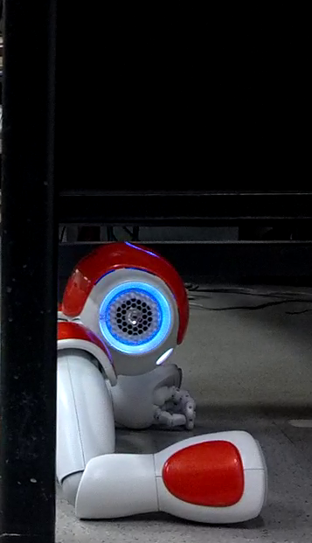
Introduction
Concept and Motivation
Humanoids are cool
Navigation is fundamental
Crawling can get you to interesting places
12/22/2016
5

Slide 6
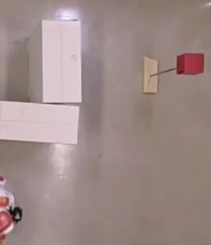
Introduction
GODZILA Navigation
Get robot from place to place
Computationally efficient
Local planner
Peformant alone, foundation of global planners
12/22/2016
6

Slide 7
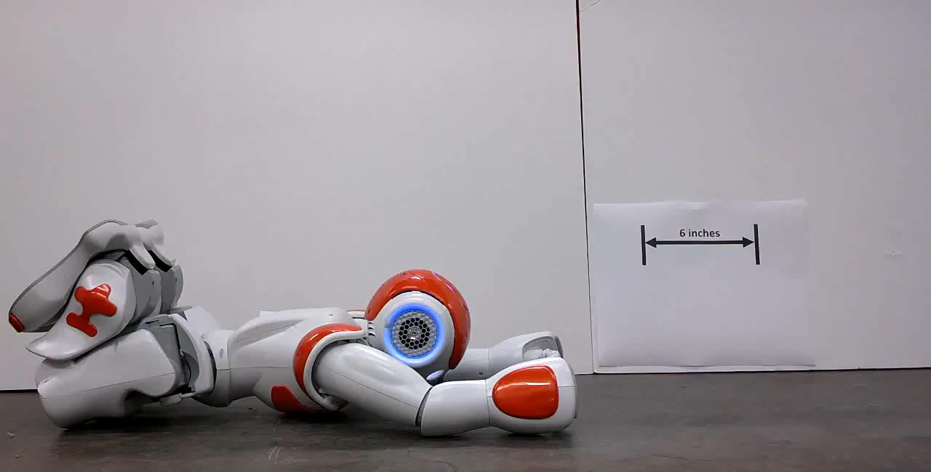
Introduction
Projected Profile
New locomotion mode
Idea is Applicable to many robots
Low profile
12/22/2016
7

Slide 8
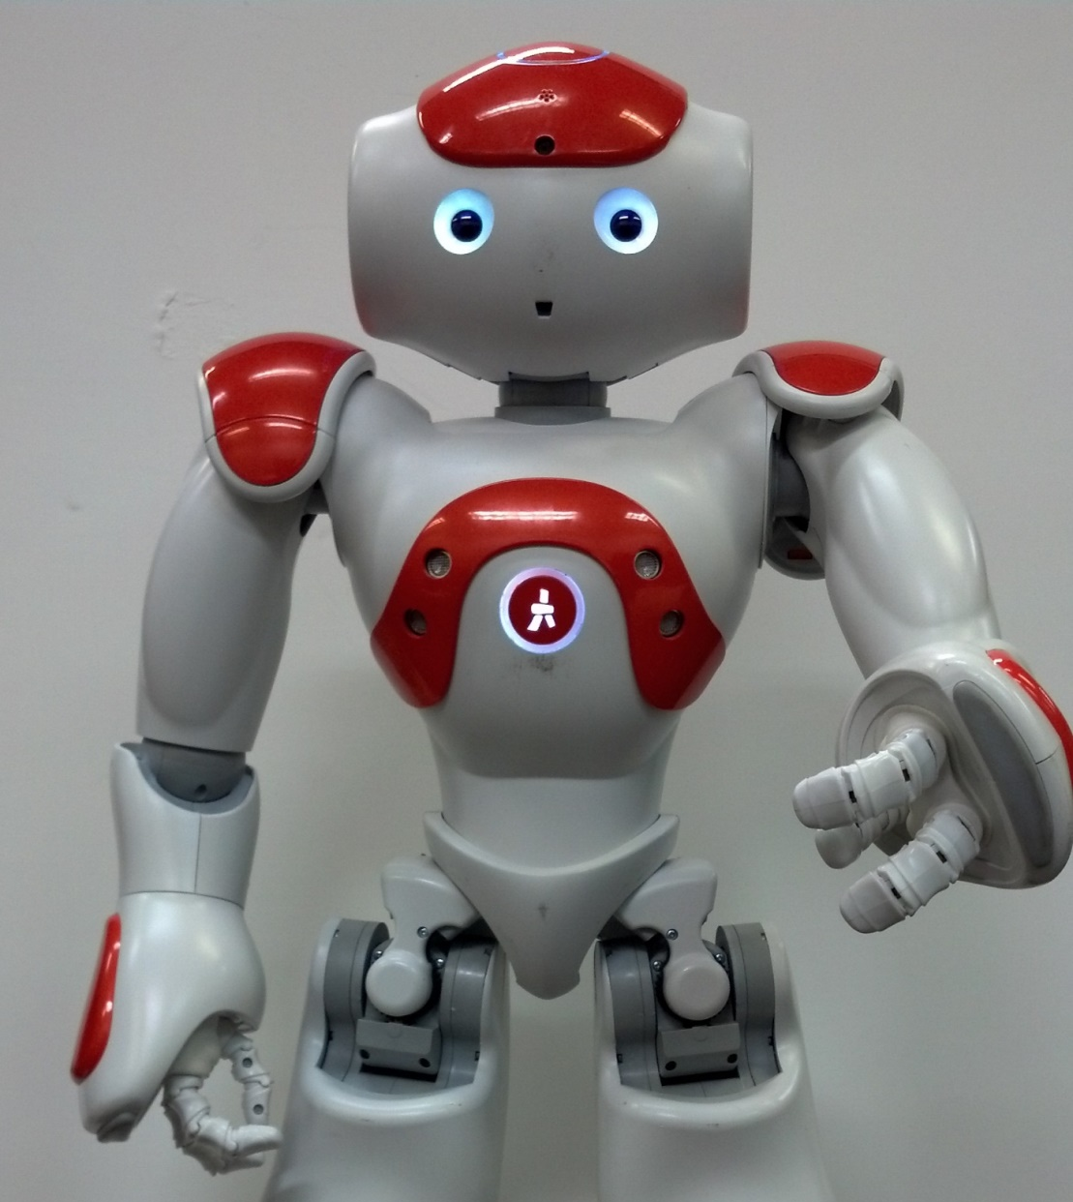
Platform Overview

Slide 9
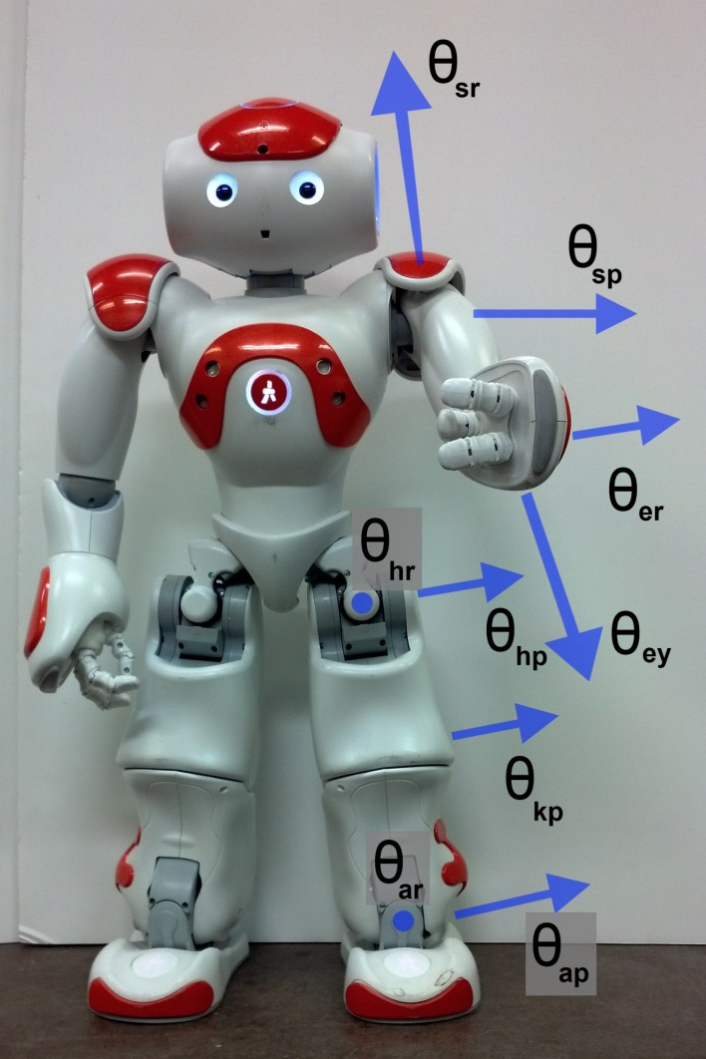
Nao Platform
Aldebaran Robotics
25 DoF humanoid, 58 cm, 4.3 kg
Atom processor, cameras, sonars, IMU
Laterally symmetric, no back joint
12/22/2016
9

Slide 10
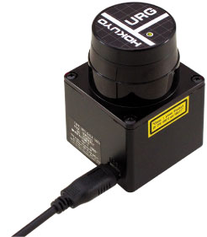
Nao Platform
Lidar
It shoots lasers to measure things
Navigation use case
12/22/2016
10

Slide 11
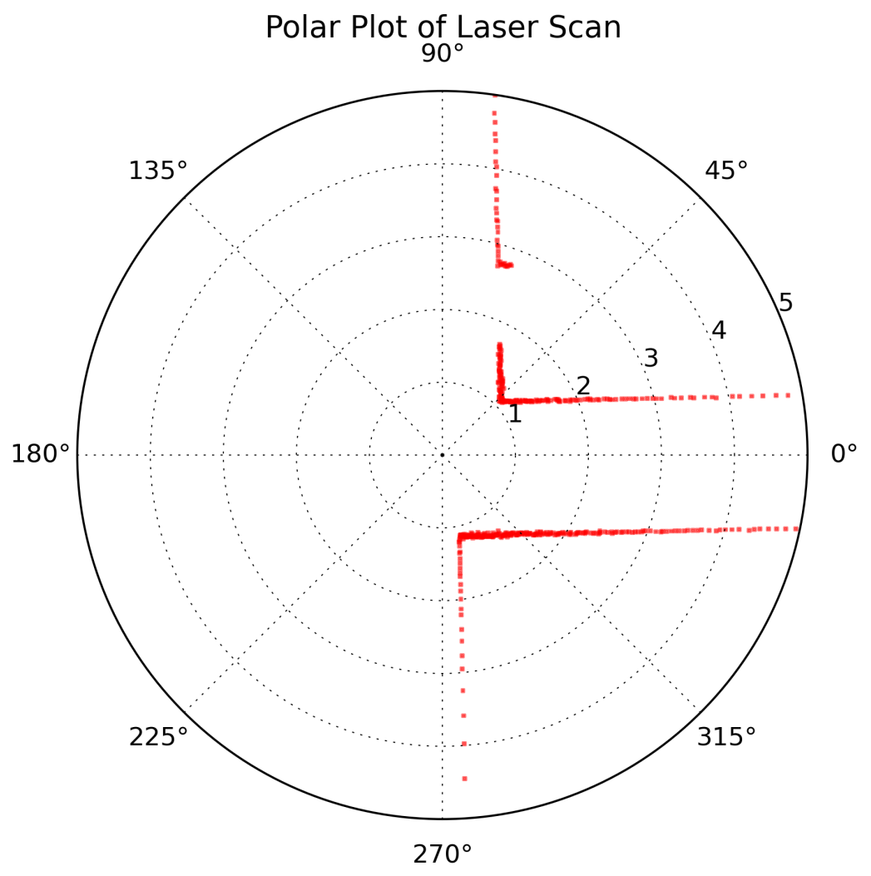
Nao Platform
Lidar
The laser returns look like this
12/22/2016
11

Slide 12
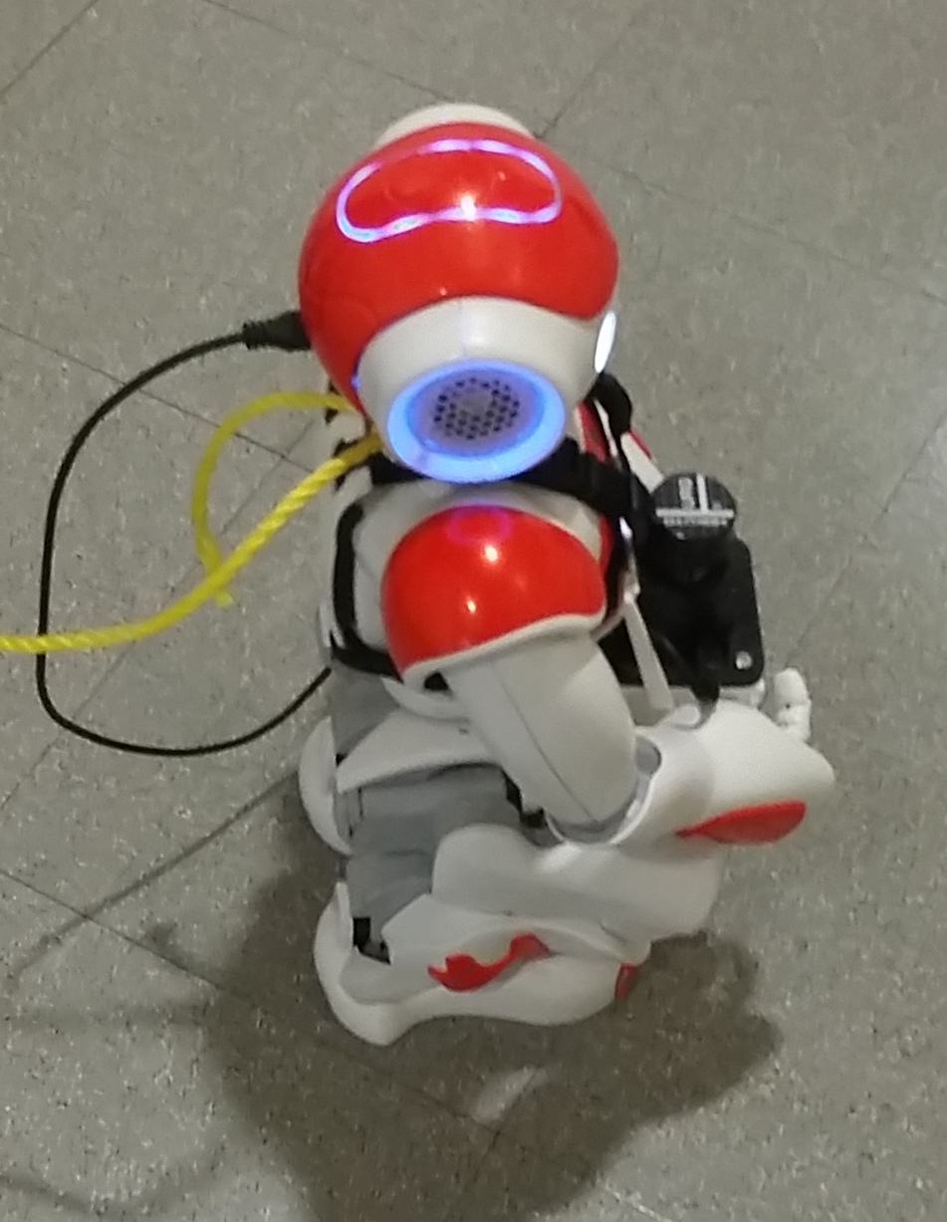
Nao Platform
Mount
Had to mount the Lidar on the Nao
12/22/2016
12

Slide 13
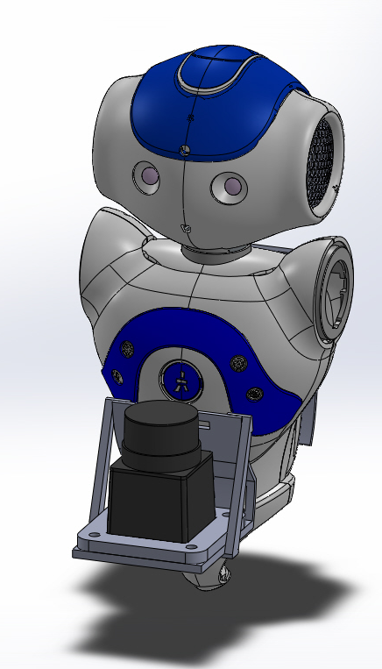
Nao Platform
Mount
CAD to be at waist
Conform to body
Low CG
Minimize wobble
12/22/2016
13

Slide 14
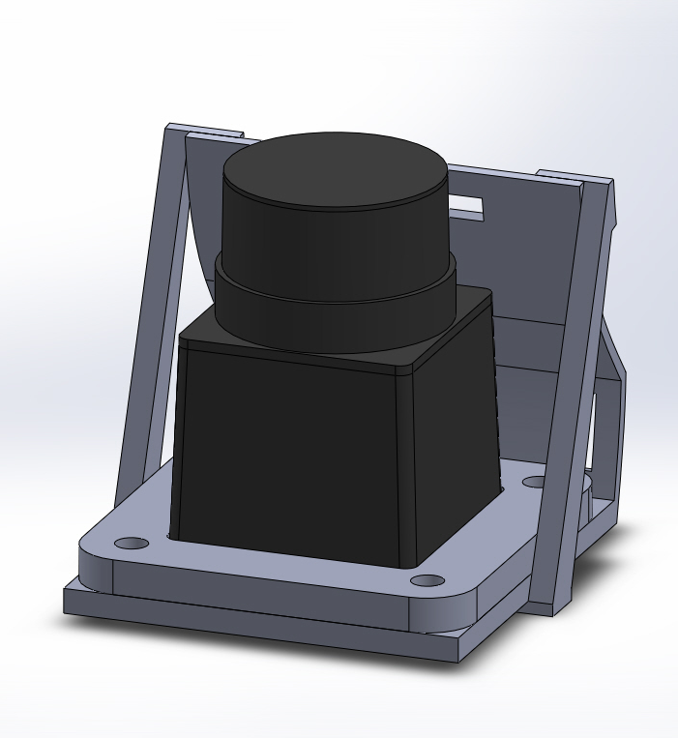
Nao Platform
Mount
Interchangeable plates
gussets
12/22/2016
14

Slide 15
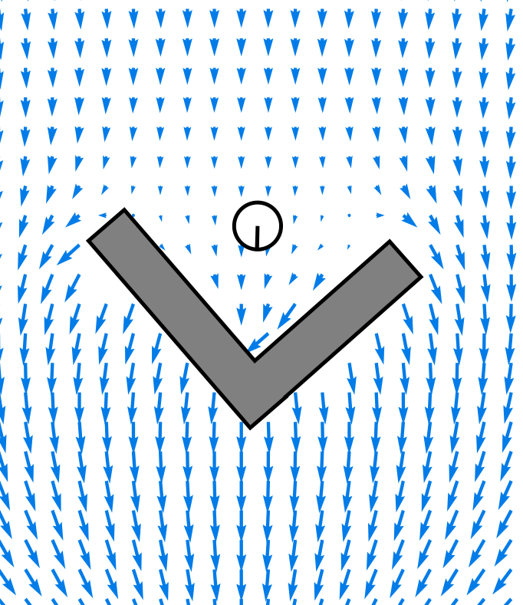
GODZILA
Navigation

Slide 16
GODZILA Navigation: Potential Fields
Potential Field intro
The world is full of obstacles, which repel
And goals which attract
12/22/2016
16

Slide 17
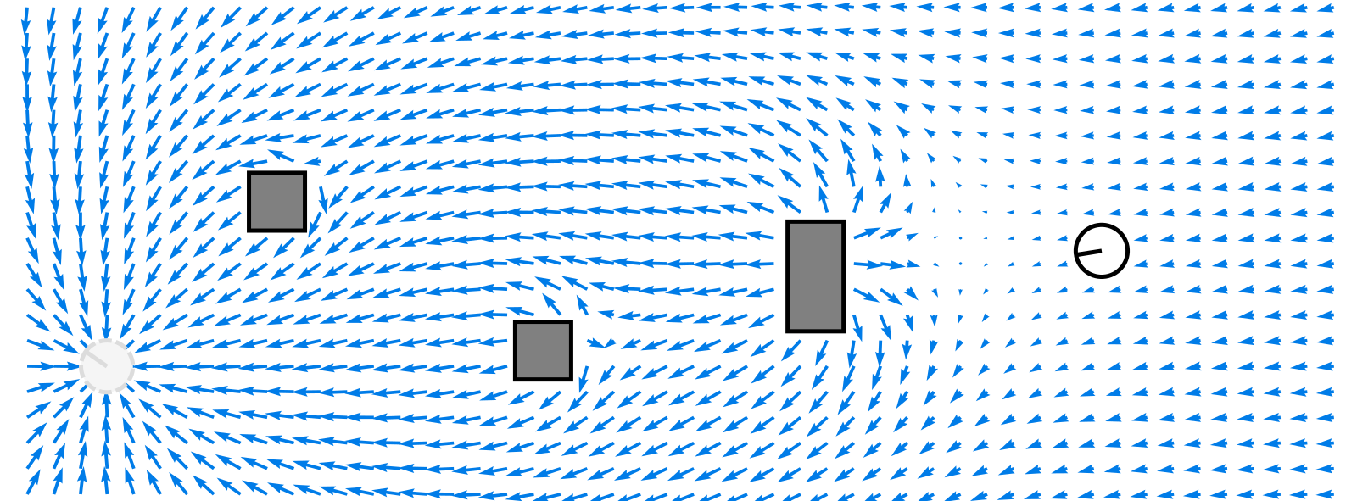
GODZILA Navigation: Potential Fields
Goal
Obstacles
Robot
12/22/2016
17

Slide 18
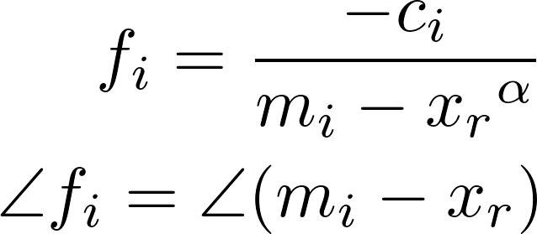
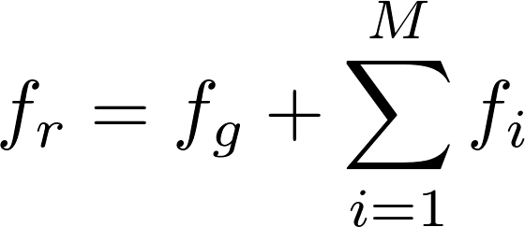
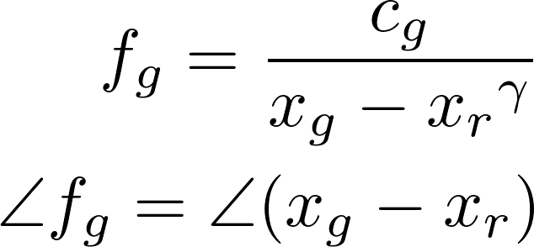
GODZILA Navigation: Potential Fields
Potential Field equations
12/22/2016
18

Slide 19
GODZILA Navigation
GODZILA Intro
It’s a local nav
potential fields based algorithm
12/22/2016
19

Slide 20

GODZILA Navigation
GODZILA Components
J1(α ′ r ) which rewards goal seeking by penalizing directions other than those towards the goal.
2. J2(α ′ r ) which penalizes directions towards occlusions.
3. Rewards directions towards far obstacles
4. J3(α ′ r ) which dampens oscillations by penalizing changes in heading
12/22/2016
20

Slide 21
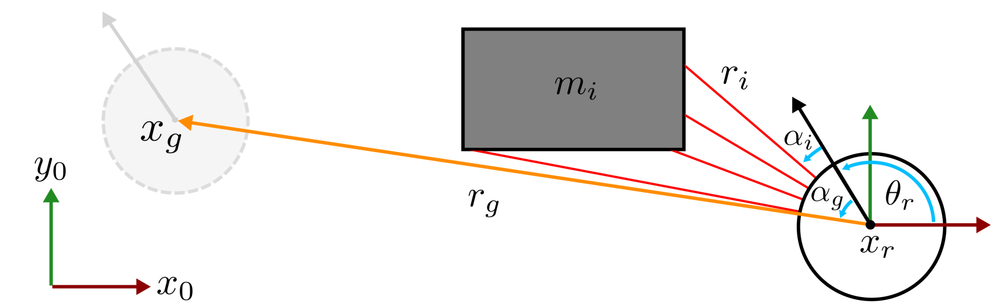



GODZILA Navigation: Parameters
12/22/2016
21

Slide 22
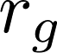
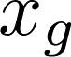
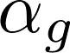
GODZILA Navigation: Parameters
12/22/2016
22

Slide 23
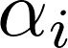

GODZILA Navigation: Parameters
12/22/2016
23

Slide 24
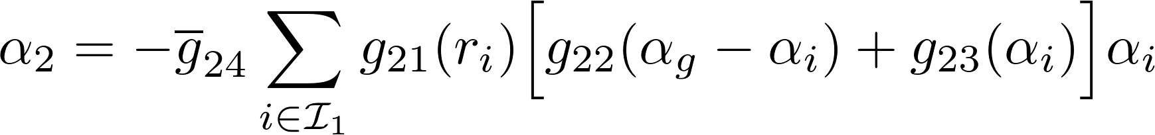
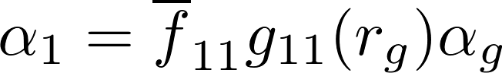
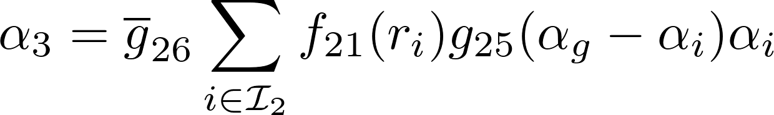
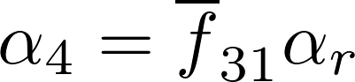
GODZILA Navigation
GODZILA equations
12/22/2016
24

Slide 25
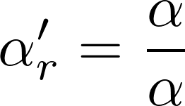
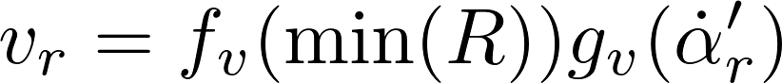
GODZILA Navigation
GODZILA equations
Alpha prime thing commanded as rate dot thing
12/22/2016
25

Slide 26
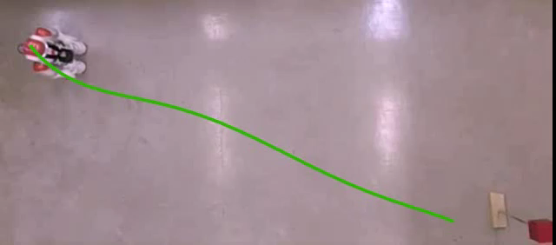
GODZILA Navigation: Open Area
12/22/2016
26

Slide 27
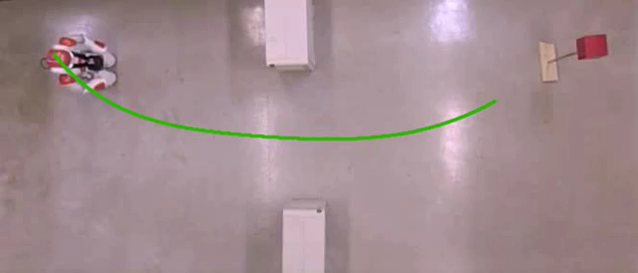
GODZILA Navigation: Narrow Opening
12/22/2016
27

Slide 28
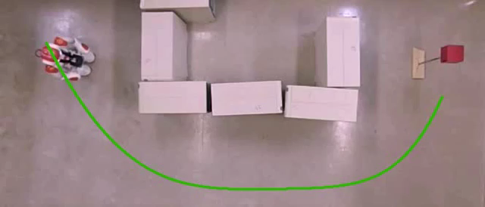
GODZILA Navigation: Square Area
12/22/2016
28

Slide 29
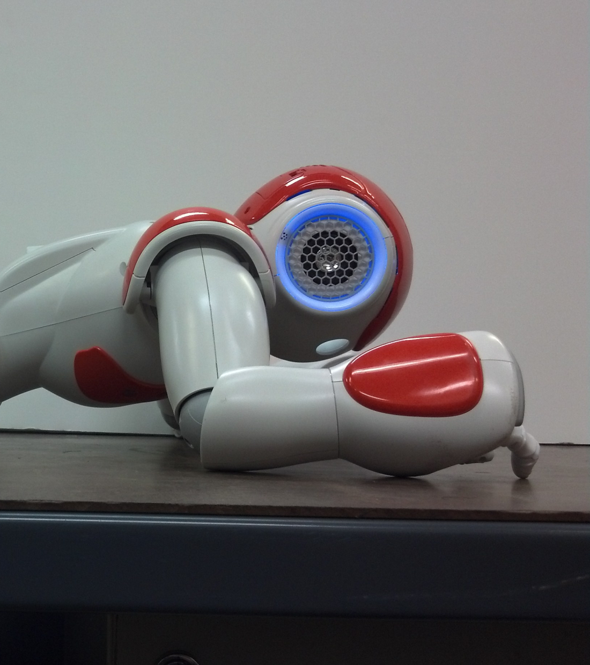
Projected Profile
Gait

Slide 30
Crawl Gait
Projected Profile
Sagittal Plane Projection
25 DoF to 6 DoF
Dual Mode
Open Chain
Move end effectors
Closed Chain
Move CoM
12/22/2016
30

Slide 31
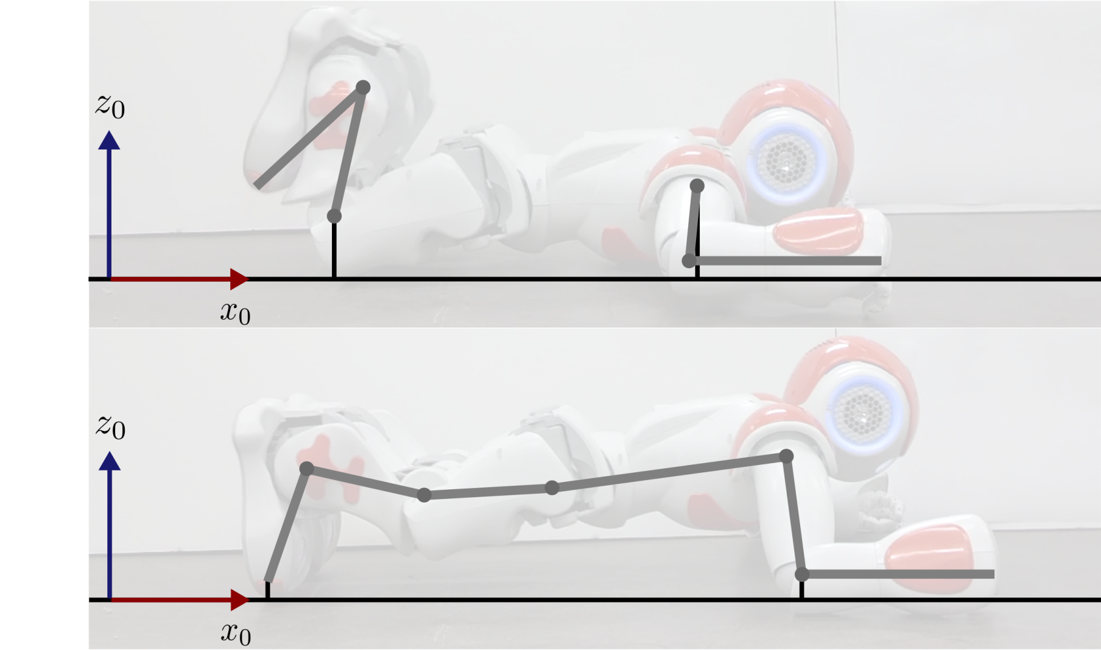
Projected Profile Gait: Concept
Open Chain
Closed Chain
12/22/2016
31

Slide 32
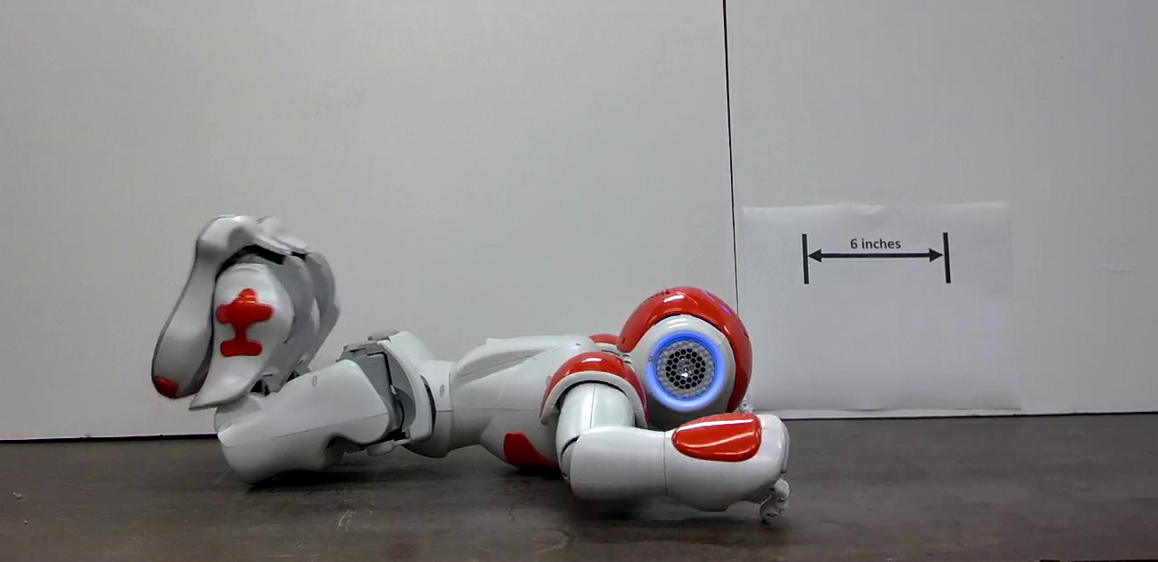
Crawl Gait: Open Chain
Open Chain
Torso on ground
Arms and legs can be positioned
ADD STICK FIGURES
12/22/2016
32

Slide 33
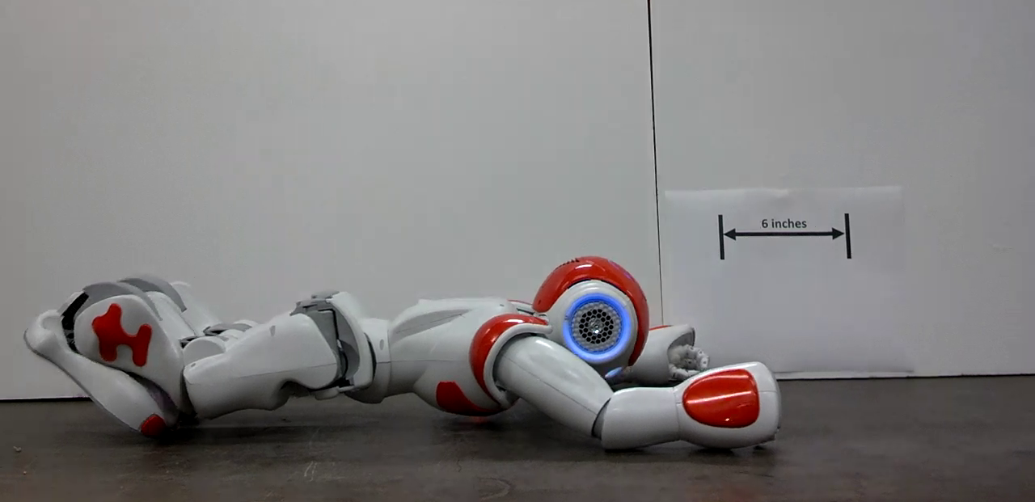
Crawl Gait: Extension
Closed Chain: Extension
Arms and legs on ground
Torso can be positioned
CoM is at initial position
12/22/2016
33

Slide 34
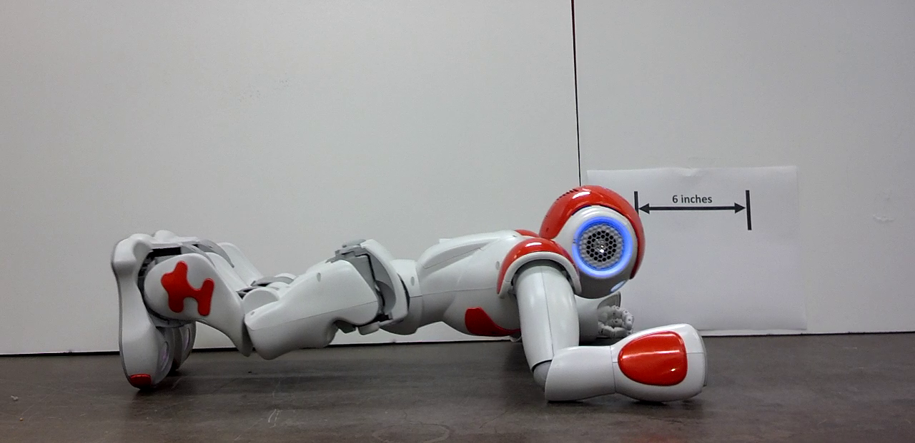
Crawl Gait: Compression
Closed Chain: Compression
CoM is at final position
12/22/2016
34

Slide 35
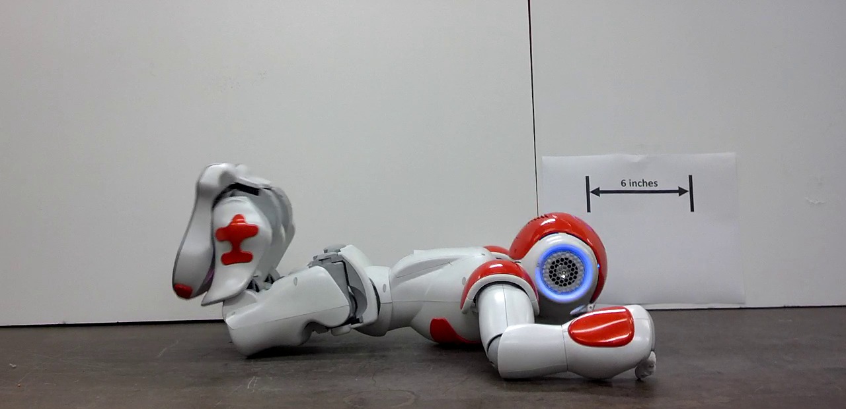
Crawl Gait: Open Chain
Open Chain
Torso on ground
Arms and legs can again be positioned
12/22/2016
35

Slide 36
Crawl Gait: Open Chain
12/22/2016
36

Slide 37
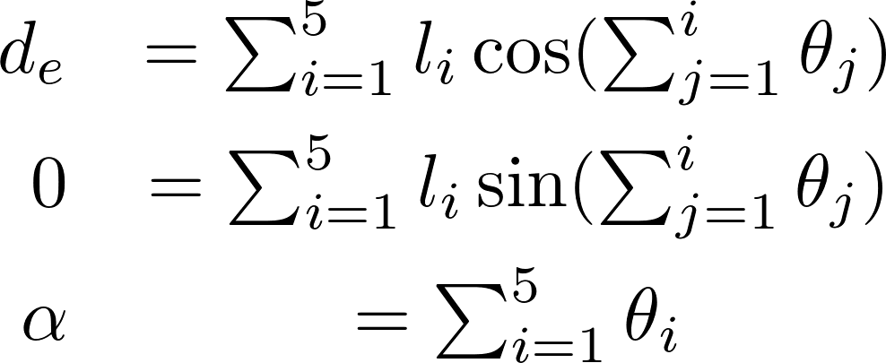
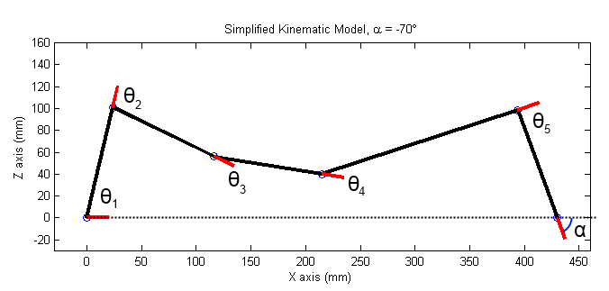
Crawl Gait: Projected Profile
Foot “joint” is not actuated
Knee and Hip as free variables
Remaining joints function of Elbow
12/22/2016
37

Slide 38
Crawl Gait: Ankle Solution
Solving for Ankle Joint
Squared sum
12/22/2016
38

Slide 39
Crawl Gait: Ankle Solution
Solving for Ankle Joint
12/22/2016
39

Slide 40
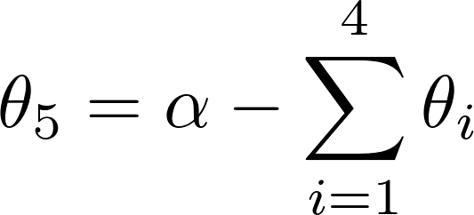
Crawl Gait: Joint Solutions
Yields two solutions for Ankle
One is kinematically infeasible
Foot joint follows from Ankle
Shoulder joint is given by:
12/22/2016
40

Slide 41
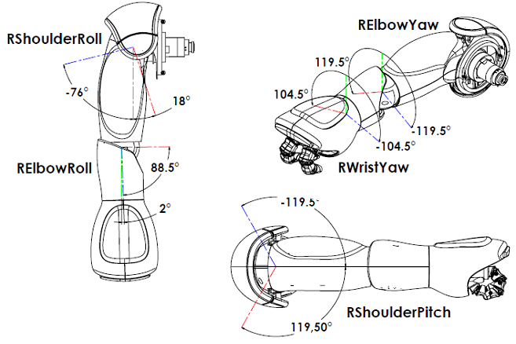

Slide 42
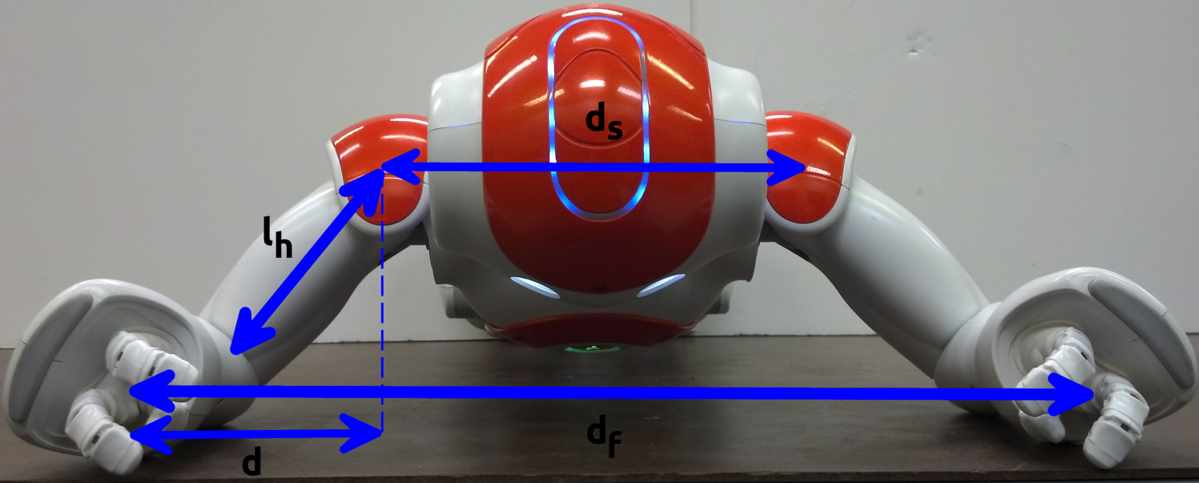
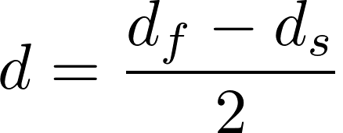

Slide 43
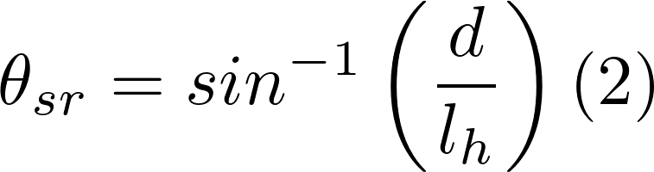

Slide 44
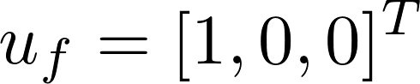
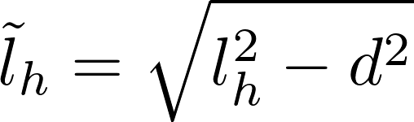
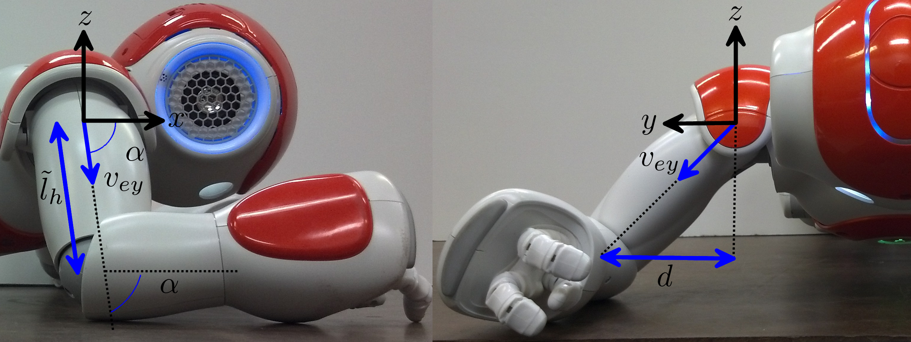

Slide 45
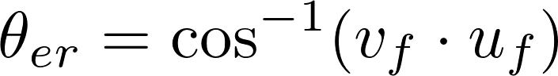

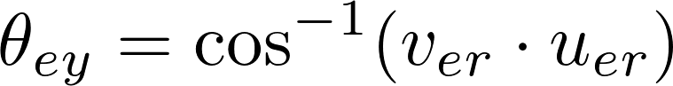


Slide 46

Crawl Gait: Projected Profile
Z axis (mm)
X axis (mm)
12/22/2016
46

Slide 47

Crawl Gait: Crawl Sequence

Slide 48

Gait Optimization

Slide 49
Gait Optimization
Knee and hip as free variables
Optimize wrt torques
Pseudo-static formulation
12/22/2016
49

Slide 50

Gait Optimization
V-REP simulation
Table of joint angles to torques
2.5° resolution
± 30° about initial pose
Linear interpolation
Genetic algorithm for optimization
12/22/2016
50

Slide 51


Gait Optimization
Cubic splines
Angle triplets
Theta alpha
12/22/2016
51

Slide 52

Gait Optimization
Cost Function
Shoulder weighted more to minimize use
Terms to prevent backtracking and use feasible joint range
12/22/2016
52

Slide 53

Gait Optimization
12/22/2016
53

Slide 54

Gait Optimization
12/22/2016
54

Slide 55

Gait Optimization
12/22/2016
55

Slide 56

Gait Optimization
12/22/2016
56

Slide 57

Crawl Gait: Projected Profile
Z axis (mm)
X axis (mm)
12/22/2016
57

Slide 58

Crawl Gait: Projected Profile
12/22/2016
58

Slide 59

Gait Optimization
Always better
12/22/2016
59

Slide 60

Gait Optimization
78.5%
12/22/2016
60

Slide 61

Conclusion

Slide 62

Conclusion
Nao Humanoid
GODZILA
Projected Profile
Optimizing free params
12/22/2016
62

Slide 63
Conclusion
Future Work
Vision based obstacle detection
Nav layers, trap avoidance
Crawl turning
12/22/2016
63

